Slide 1
Taxi Service Trajectory in Portugal
By
Ryan D’souza

Slide 2
Relevancy + Interesting
What time of day do most people need taxis?
Indicate the number of people relying on them
After a night out
To get around in the middle of the day
Indicates parking problems
What is the best way to get a taxi
Helpful for taxi drivers and companies looking to optimize revenue
Helpful for clients to find the quickest taxi
Is Uber surge pricing at the right times?
Their data is anonymous, but they shouldn’t be surge pricing when taxi demand is low

Slide 3
Data Information
Source:
http://archive.ics.uci.edu/ml/datasets/Taxi+Service+Trajectory+-+Prediction+Challenge%2C+ECML+PKDD+2015

Slide 4
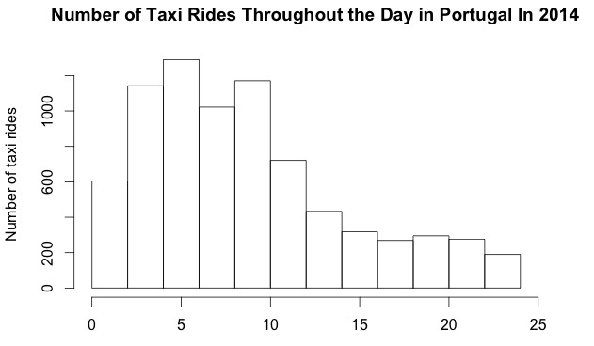
Frequency of Hailing Times for Taxis Per Day

Slide 5
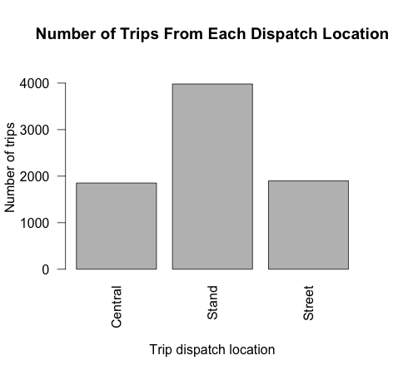
Frequency of Various Dispatch Locations

Slide 6
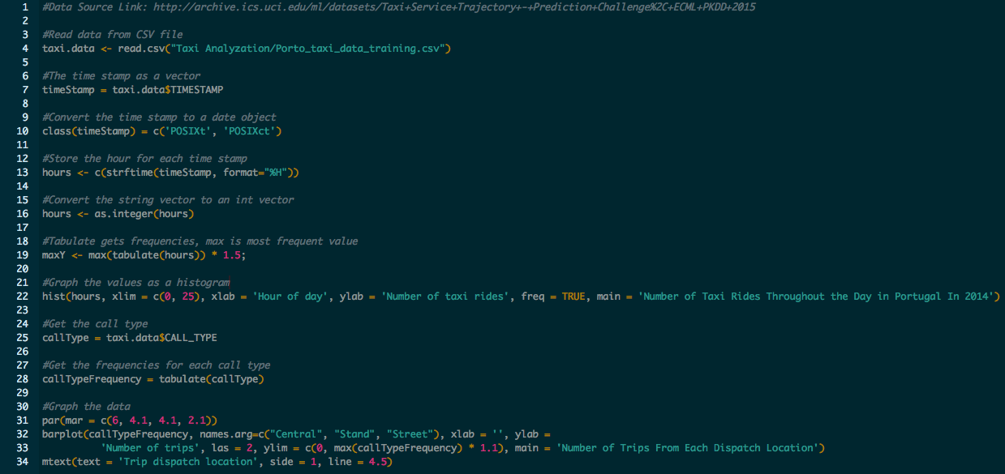
Source Code

Slide 7
Future Analysis
Any correlation between returning customers (by phone numbers) and taxi drivers
Trip length
By customer → who takes the longest journeys
By location → which drivers in which spots have to drive the most
By call location → where are long-term drivers dispatched from

